Slide 1
API Examples
Pravin Y Pawar

Slide 2


API
API stands for ‘Application Programming Interface'
Technically,
an API describes how to connect a dataset or business process with some sort of consumer application or another business process
We are probably familiar with a lot of the big names that use APIs all the time
For example,
whenever use Facebook account to join another site, login request is being routed via an API
whenever use the Share functions of an application on your mobile device, those apps are using APIs to connect you to Twitter, Instagram, etc.

Slide 3
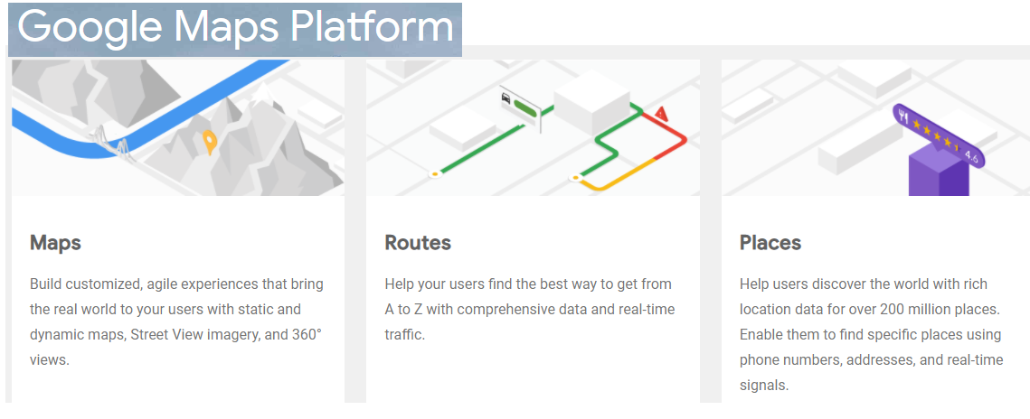
Mapping API
Google Maps
When you search for an address, an API helps interact with a map database to identify the latitude and longitude, and other related data, for that address
The API also makes it possible for a mapping interface to then display
the address on the map
any additional information such as the directions to that destination

Slide 4
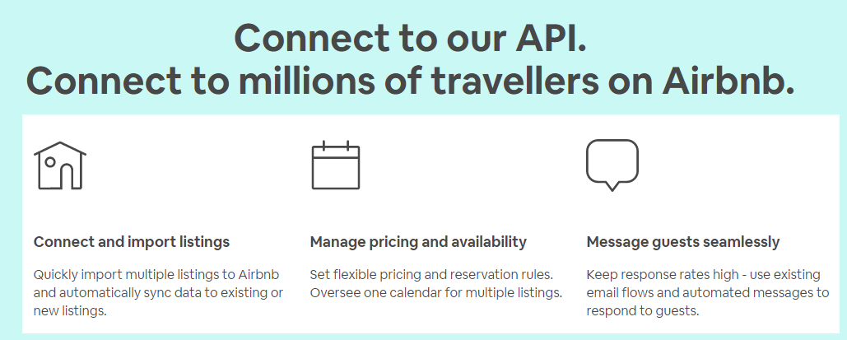
Business APIs
Airbnb
When you search for hotel online, API helps you
to interact with hotels database
filter out the entries based upon your specification
Do the booking

Slide 5

Payment APIs
Payment APIs are APIs (Application Programming Interfaces) designed for managing payments.
They enable eCommerce sites to process:
credit cards,
track orders,
and maintain customers lists.
In many instances, they can help protect merchants from fraud and information breaches.
Source : rapidapi

Slide 6
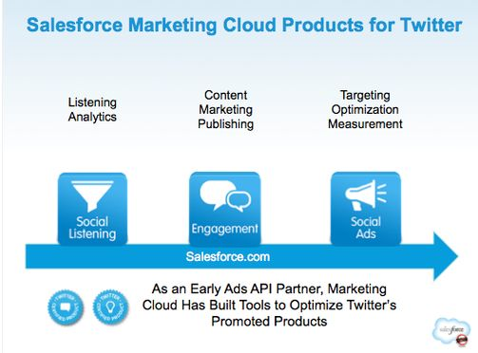
Marketing API
Marketing APIs are a collection of API endpoints that can be used to help you advertise on social media platform like Facebook, Twitter etc.
Amazon offers vendors and professional sellers the opportunity to advertise their products on Amazon
Source : pinterest

Slide 7
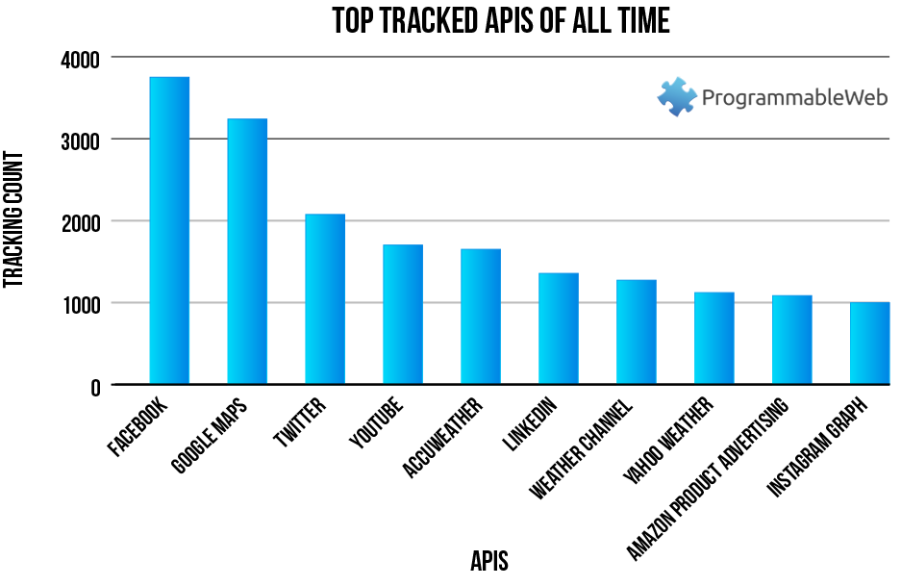
Popular APIs
Source: programmable web

Slide 8
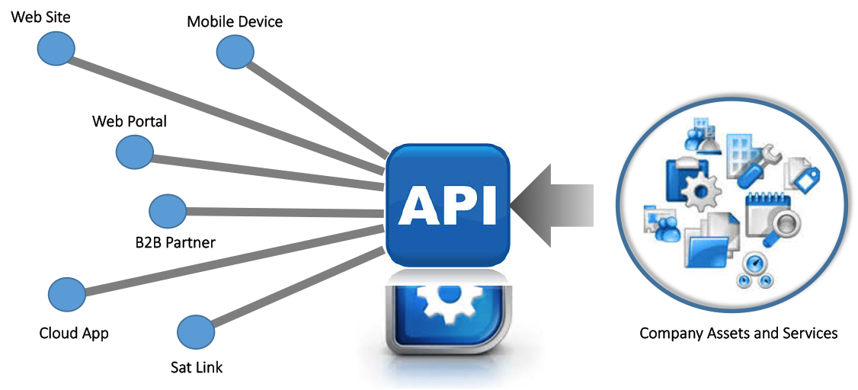
APIs
API services are much more than just a description of how to access a database or how to help a machine read the data!
Enable a business to become a platform.
APIs help you break down your business products and services into compassable functions you can share with other businesses for direct insertion into their processes.
APIs provide a way for businesses to leverage new markets
allow partners and third-party developers to access a business’ database assets, or create a seamless workflow that accesses a business’ services.
Source : forum systems

Slide 9
Thank You!
In our next session:

